Slide 1

Sentiment Analysis on Arabic Reviews
Basant Allam
John Sedrak
Lojain El Sayed

Slide 2

Our Task
Sentiment Analysis for Arabic hotel, book & airline reviews

Slide 3
Dataset: Arabic 100k Reviews
Three classes (Mixed, Negative and Positive).
Hotel, book and airline reviews
Hotel and book reviews from the HARD and BRAD datasets.
Airline reviews were collected manually from 100 airlines reviews.

Slide 4
Sample Data
Class | Sample Data Points
Positive | ممتاز . كل شي ممتاز في الفندق طاقم الاستقبال رائع والفندق رائع ونظيف.
Mixed | مرضي. سعر الغرف غالي جدا
Negative | سوء أدب موظف الاستقبال مخيب للأمل.

Slide 5
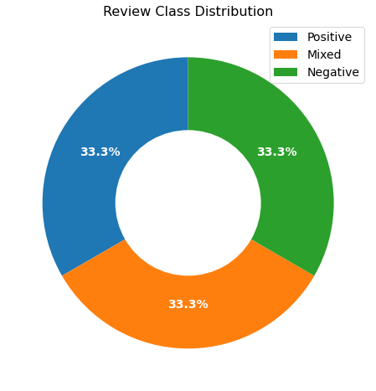
Data Analysis
Class | Data Points
Positive | 33,333
Negative | 33,333
Mixed | 33,333

Slide 6
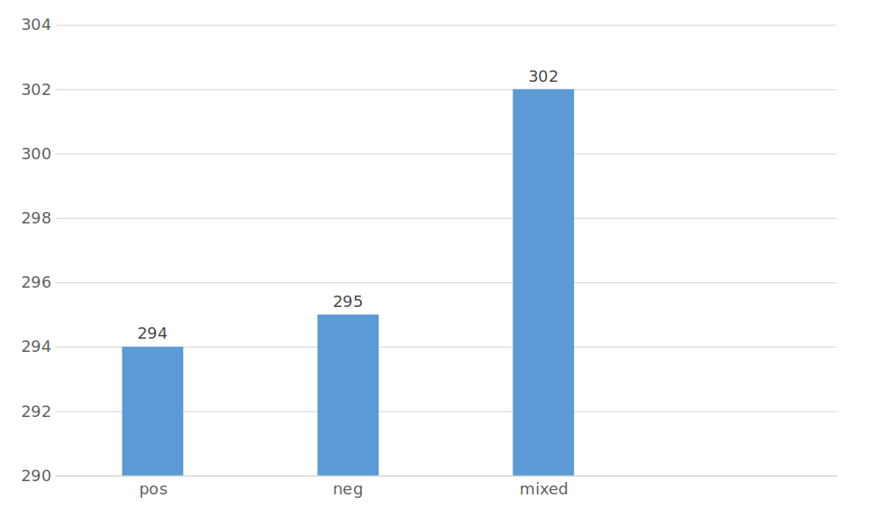
Data Analysis
Average Review Length

Slide 7
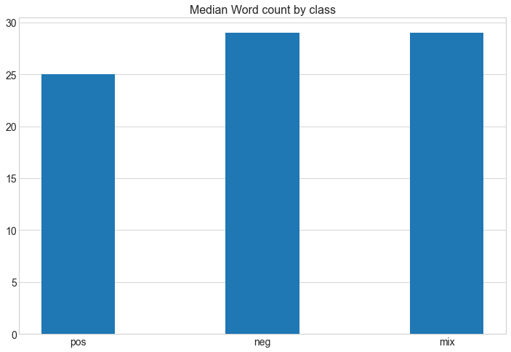
Data Analysis

Slide 8
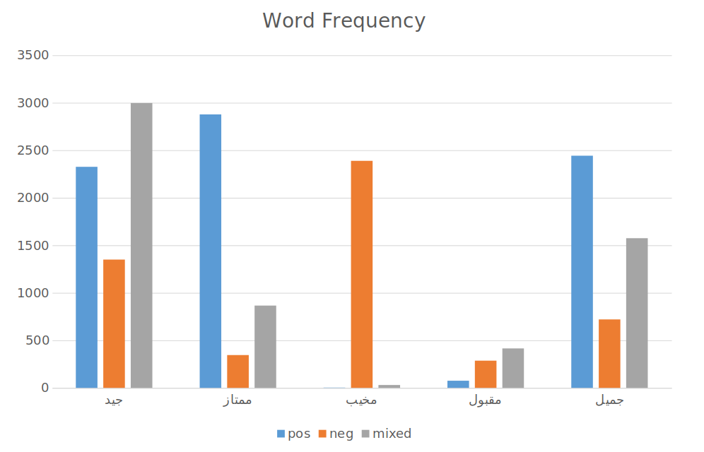
Data Analysis

Slide 9
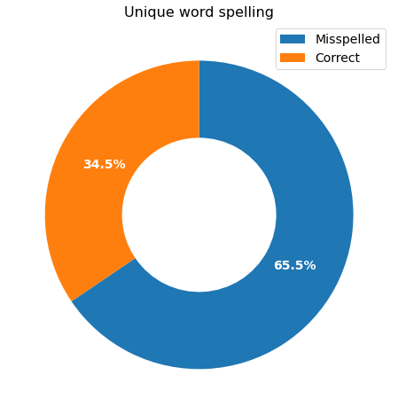
Data Analysis
Spelling | Vocab Size
Misspelled | 53,035
Correct | 27,934

Slide 10
Challenges
Arabic slang
Words with repeated characters “حلوووو اوييييي”
Spelling mistakes
People usually don’t use diacritics (تشكيل) when typing online.
Data availability

Slide 11
Pipeline
Pre-processing
Fine-tune the pretrained transformer on our dataset

Slide 12
Preprocessing
1
2
3
4
5
Remove Diacritics
Remove Misspelled Words
Lemmatiztion
Tokenization
Padding

Slide 13
Fine-tuning MARBert*
Will use pretrained MARBert model
Network architecture: same as BERTBase (12 layers, 768 hidden units, 12 heads)
Pre-trained on: Masked Language Modeling. Where 15% of the input tokens are selected for replacement. (>15 Arabic datasets)
Of which:
80% replaced with the [MASK] token
10% with a random token
10% with the original token
*from ARBERT & MARBERT: Deep Bidirectional Transformers for Arabic, 2021.

Slide 14
Thank you

